Slide 1
Software Development on Java
Dzmitry Marchankau 2023

Slide 2
Software development life cycle
Software development methodologies
Agile methodologies
Continuous integration
Software quality

Slide 3
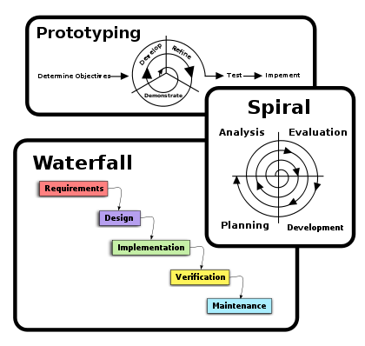
Software development methodologies

Slide 4
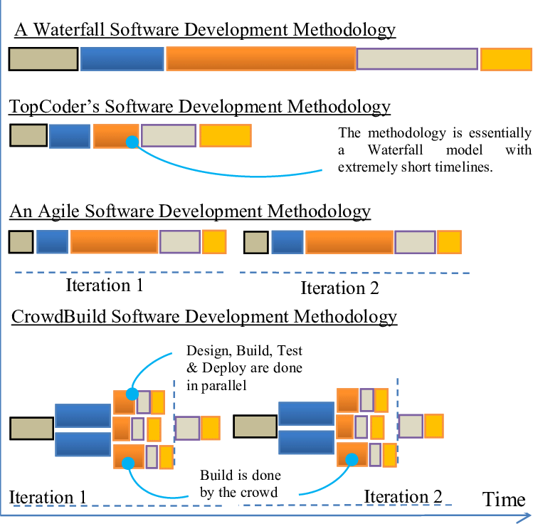
Software development methodologies

Slide 5
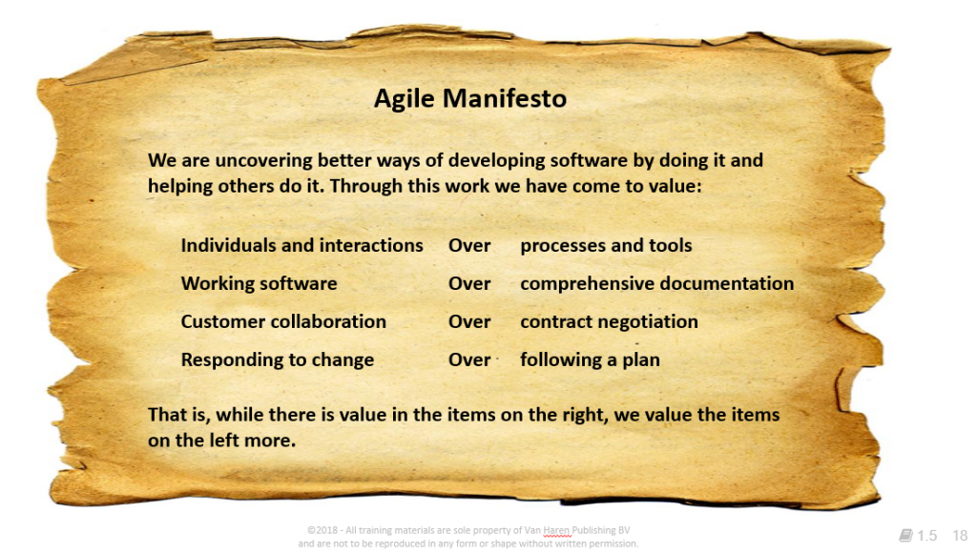
Agile manifesto

Slide 6
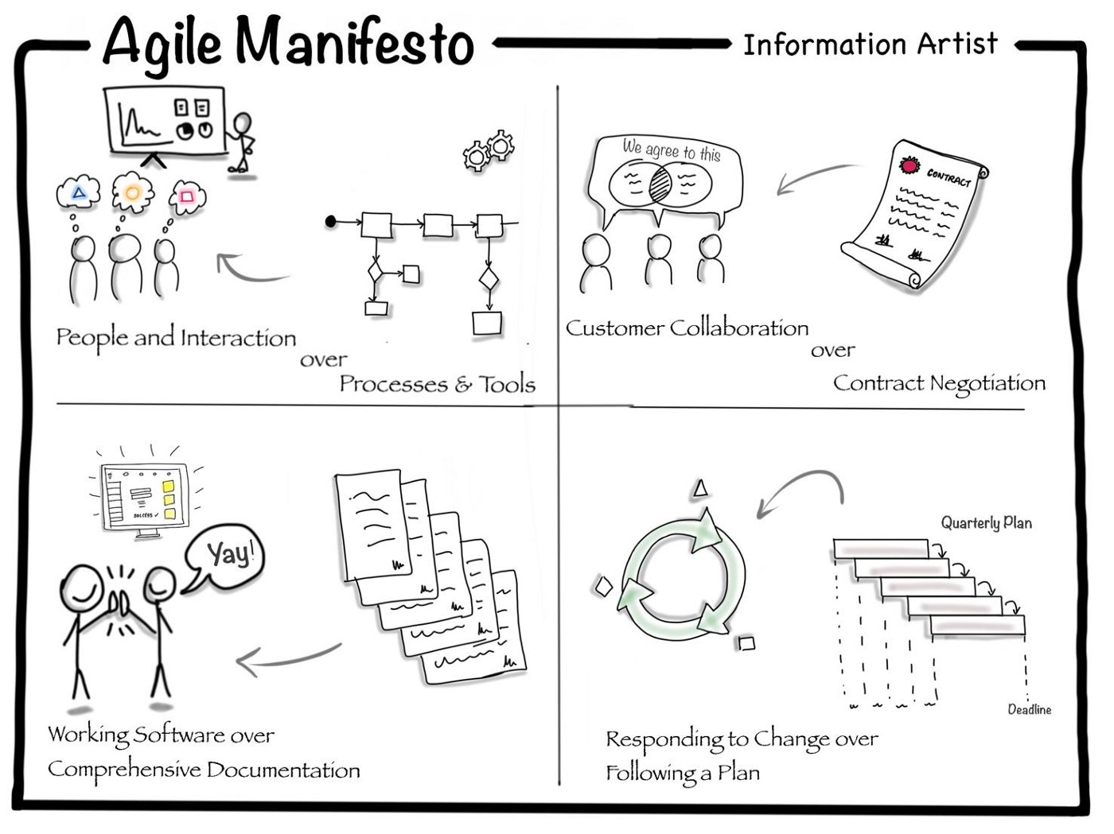
Agile values

Slide 7
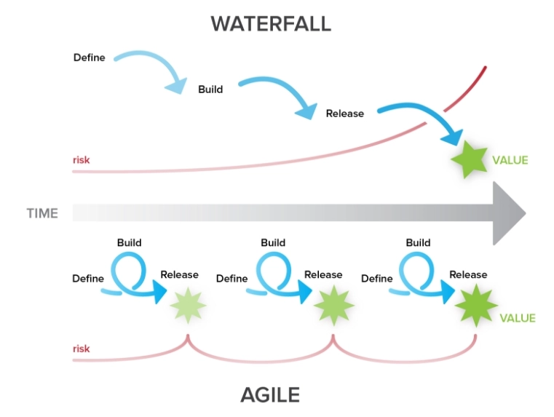
Agile vs Waterfall

Slide 8
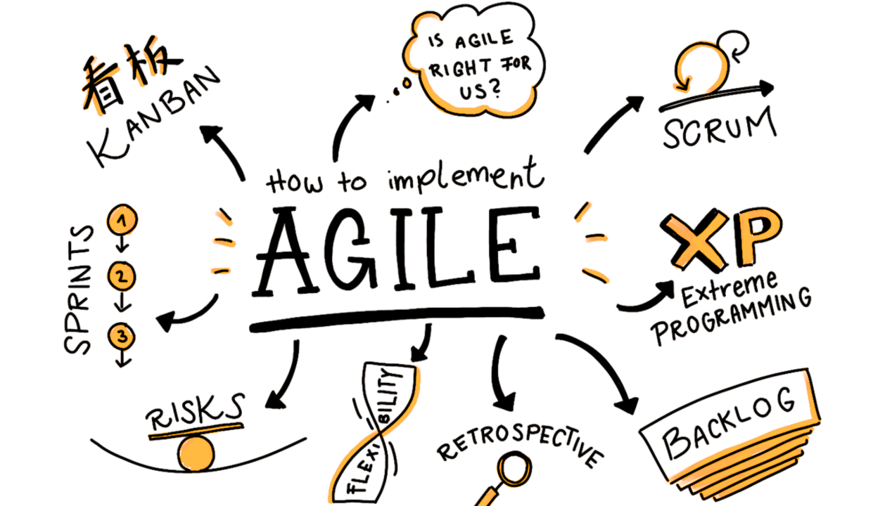
Agile methodologies

Slide 9
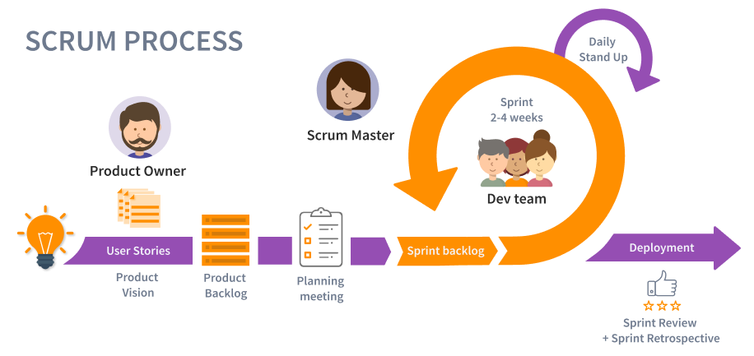
Scrum process

Slide 10
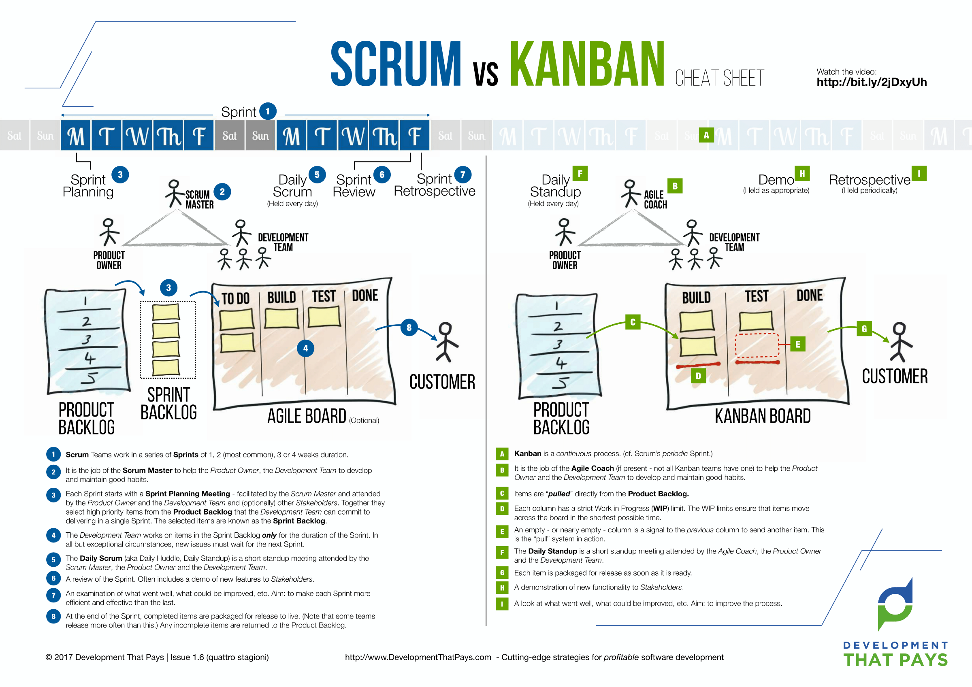
Scrum vs Kanban

Slide 11
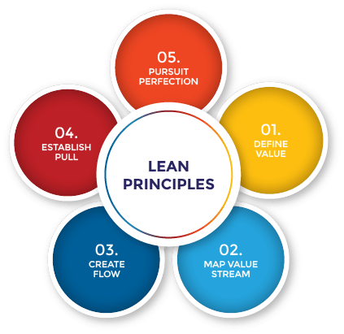
LEAN principles

Slide 12
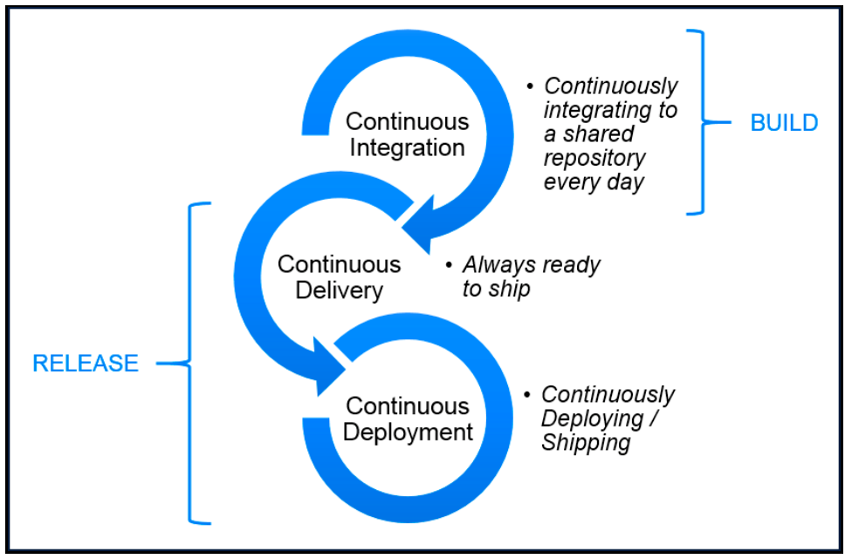
CI/CD

Slide 13
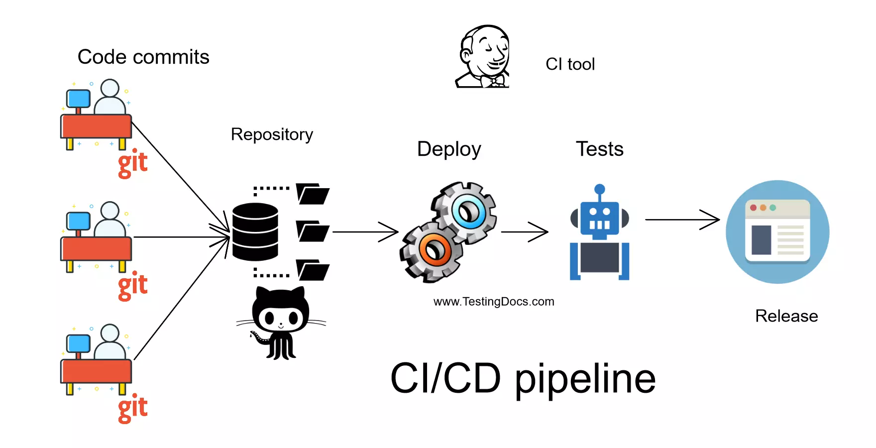
CI/CD pipeline

Slide 14
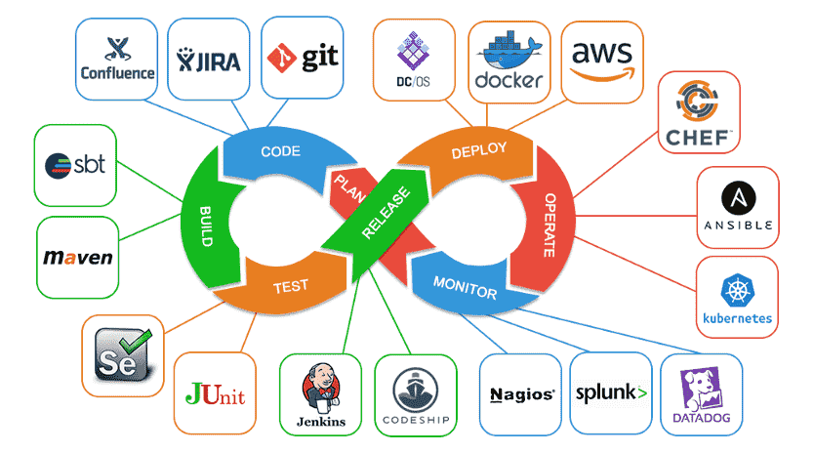
CI/CD tools

Slide 15
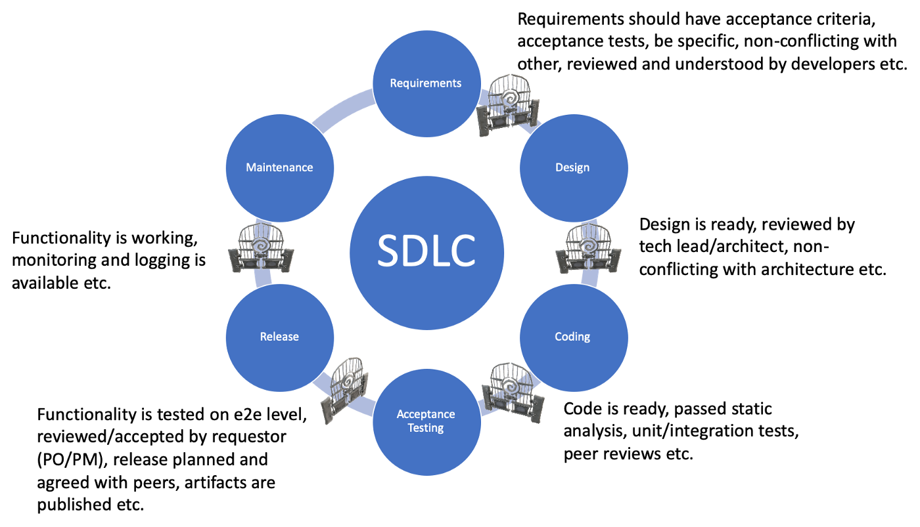
Quality gates

Slide 16
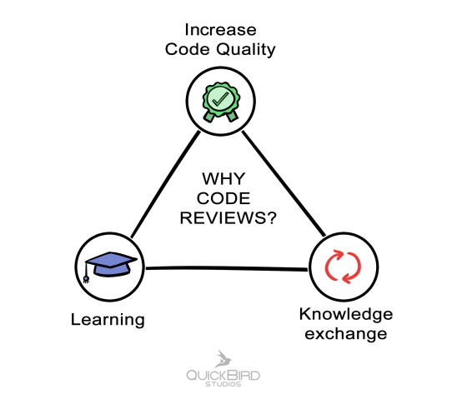
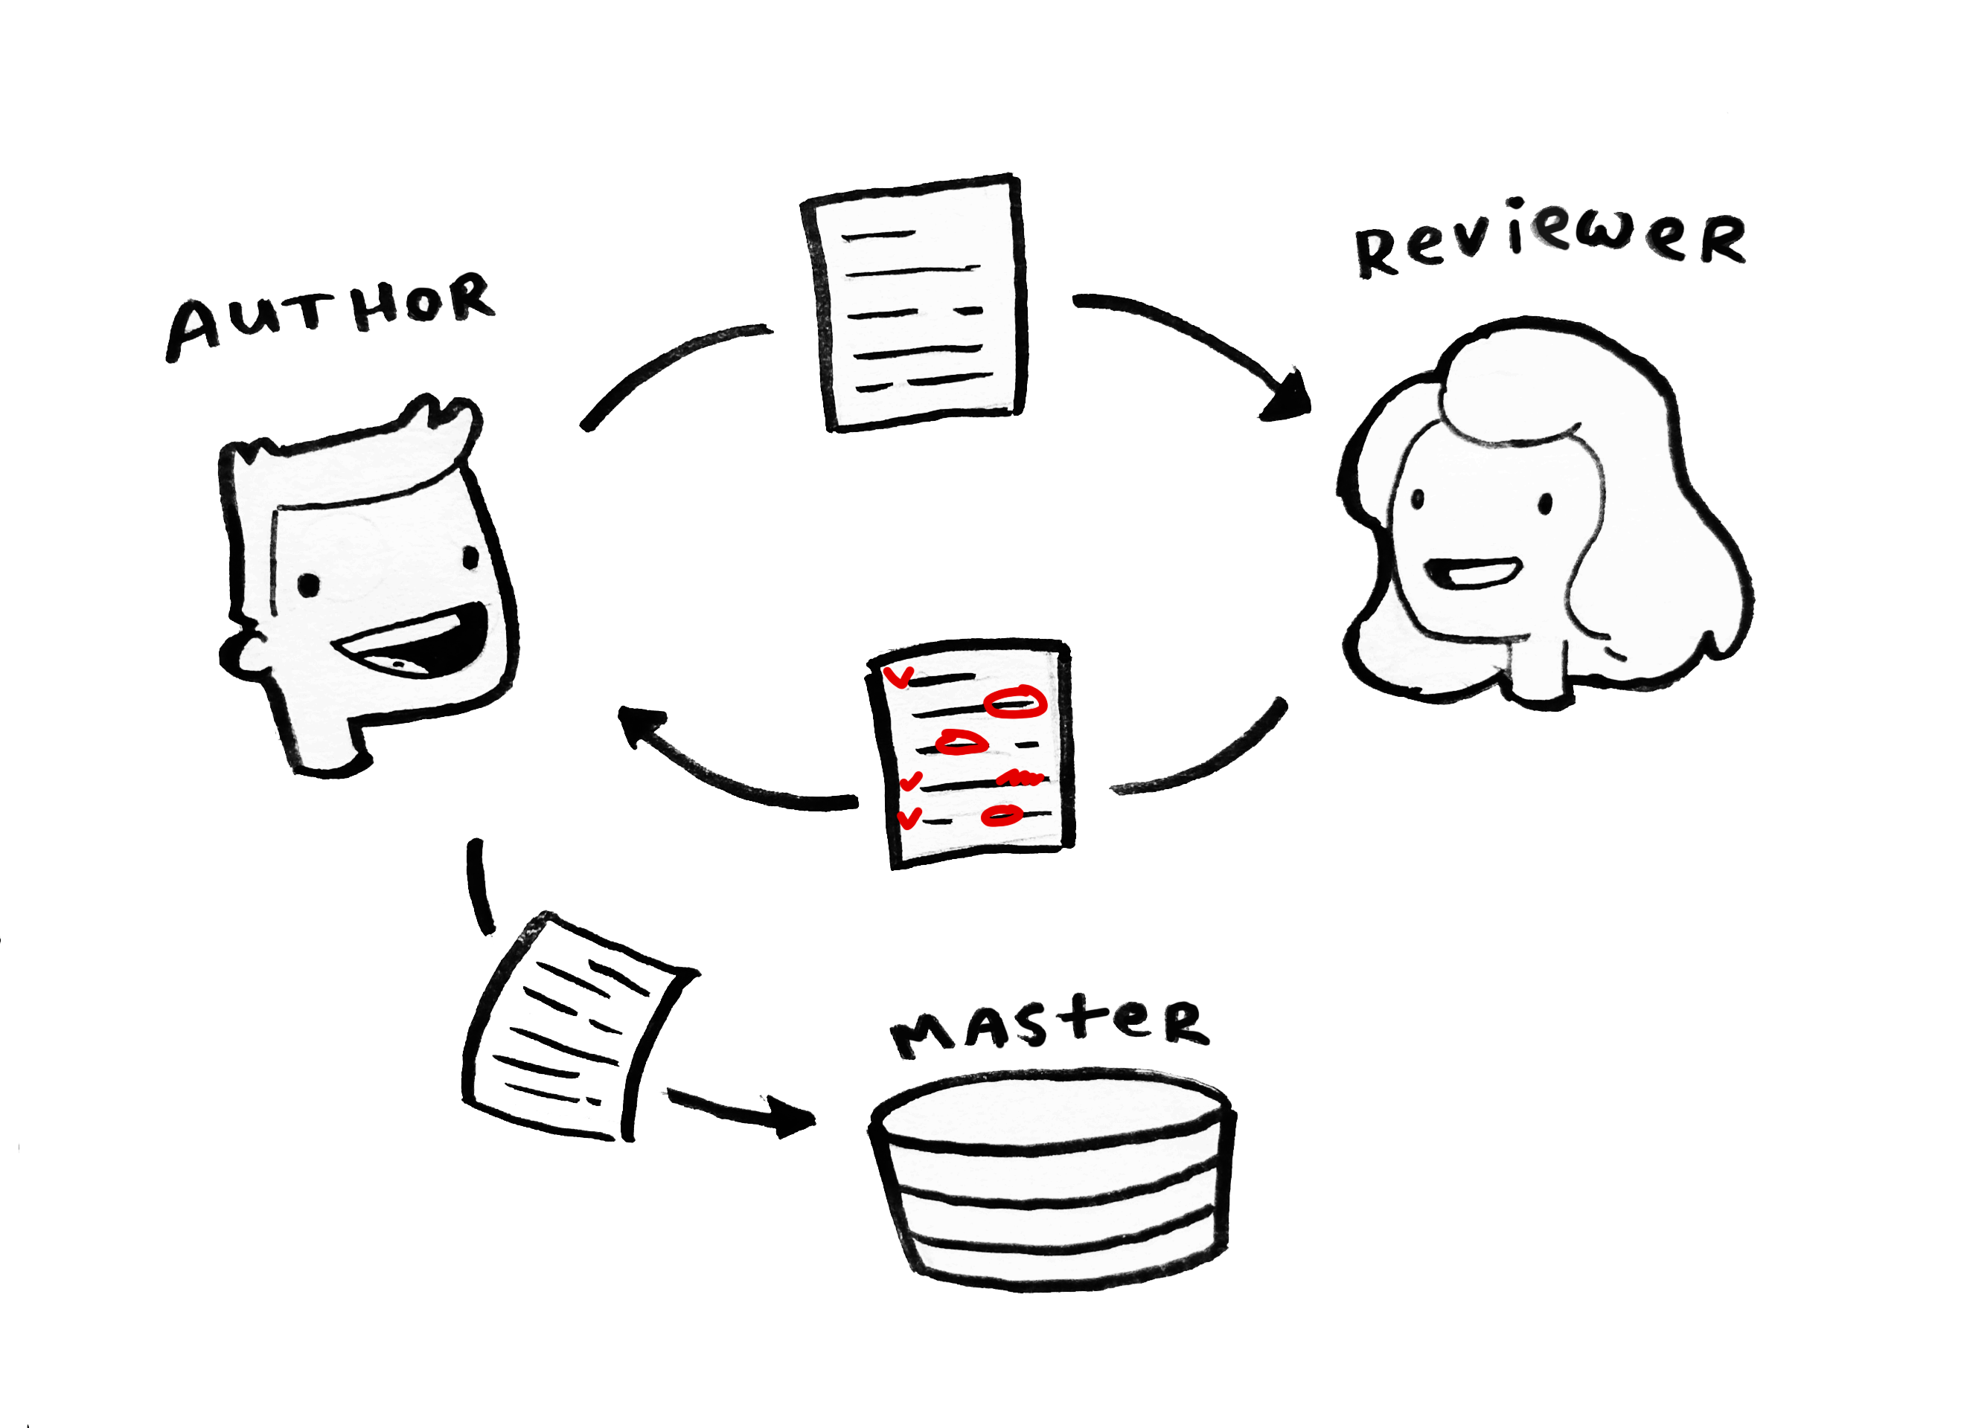
Code review

Slide 17
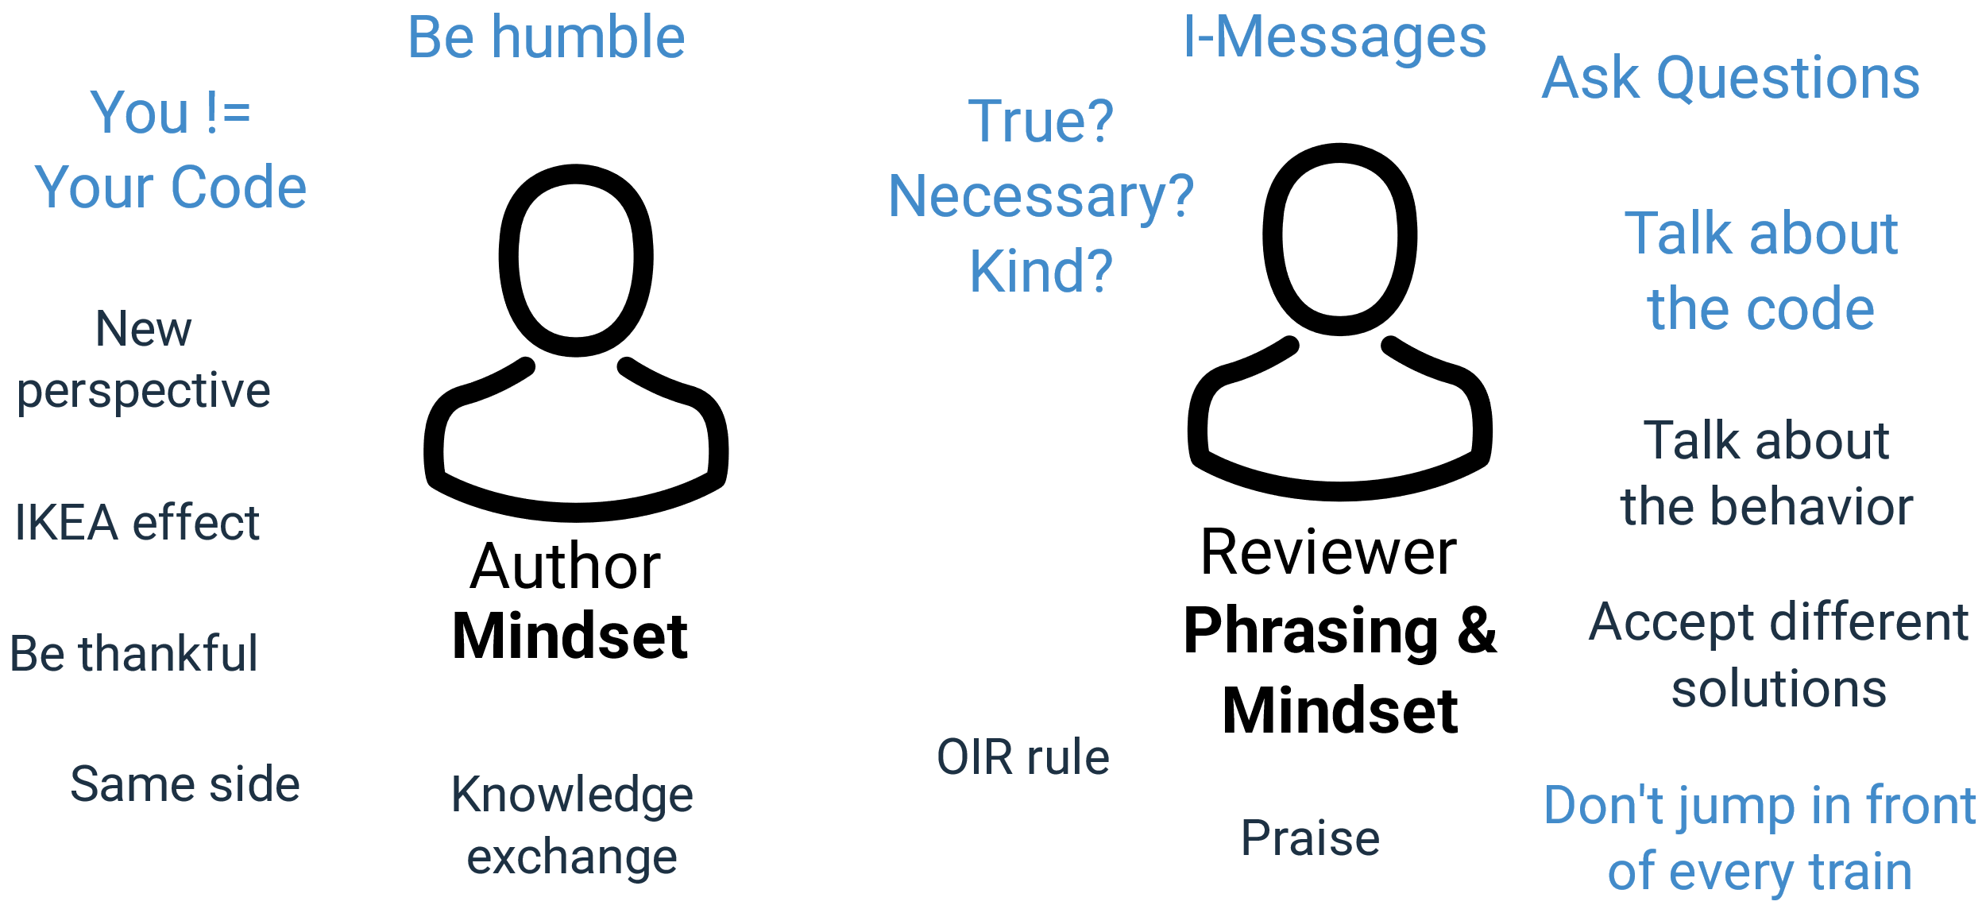
Code review tips

Slide 18
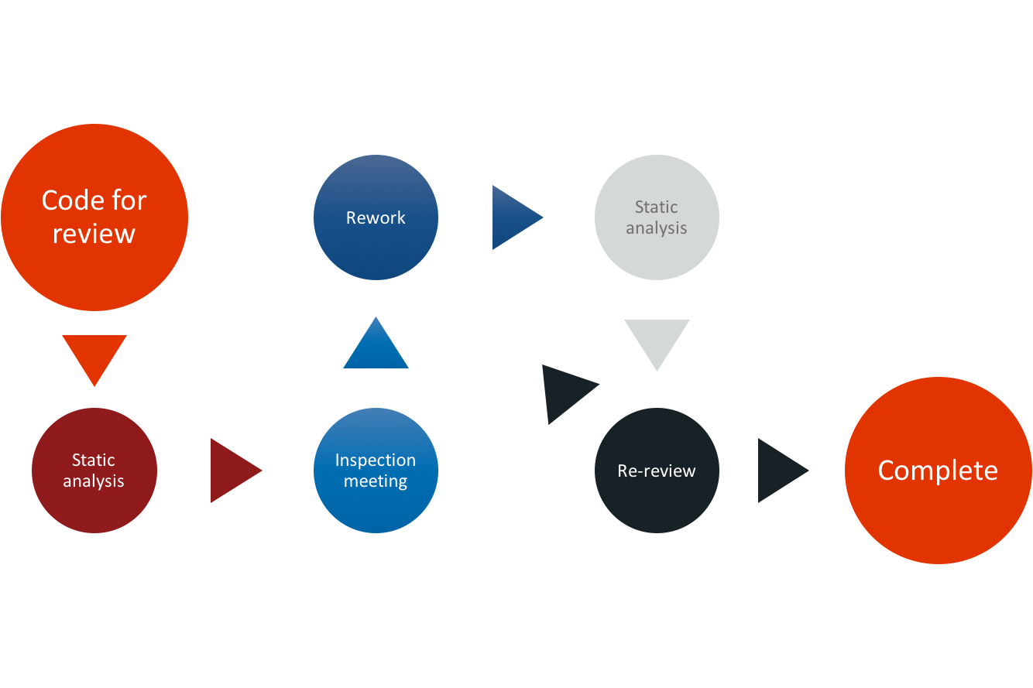
Static code analyzers

Slide 19
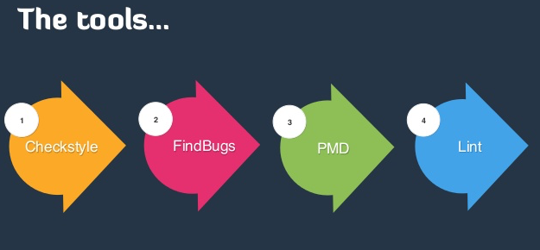
Static code analysis tools

Slide 20
Questions ?

